Slide 1
modelling fly smelling
Gerick Lee
22 August 2016

Slide 2
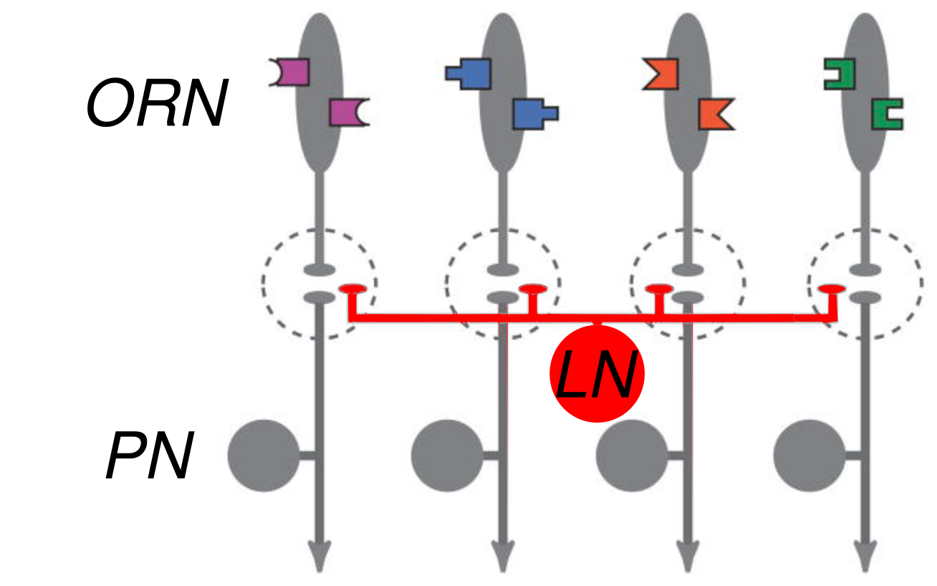
Background - circuit organization
from Wilson, 2004

Slide 3
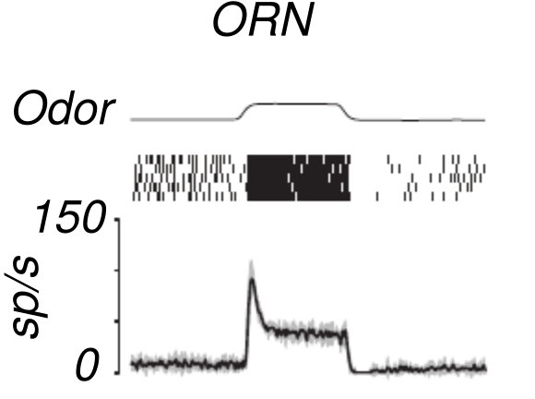
ORN responses - strong onset transient
from Nagel + Wilson, 2011

Slide 4
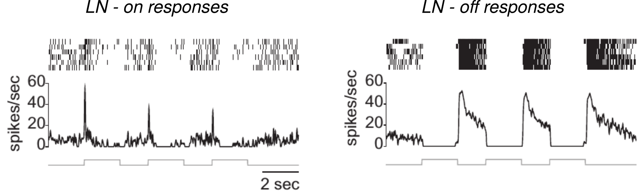
LN responses - sharp on and off responses
from Nagel et al., 2016

Slide 5
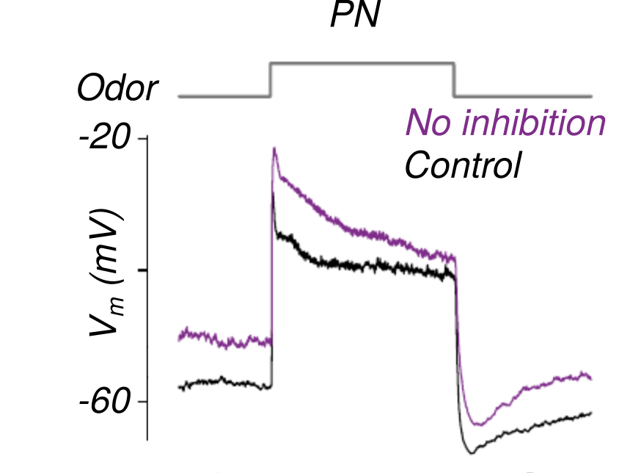
PN responses - softer onset than ORNs
from Nagel et al., 2015

Slide 6
Inhibition weakens PN onsets
from Nagel + Wilson, 2011
from Nagel et al., 2015

Slide 7
Circuit summary
ORNs - Onset transients
LNs - Bursts at odor on/off
PNs - Closer match to shape of stimulus
from Wilson, 2004

Slide 8
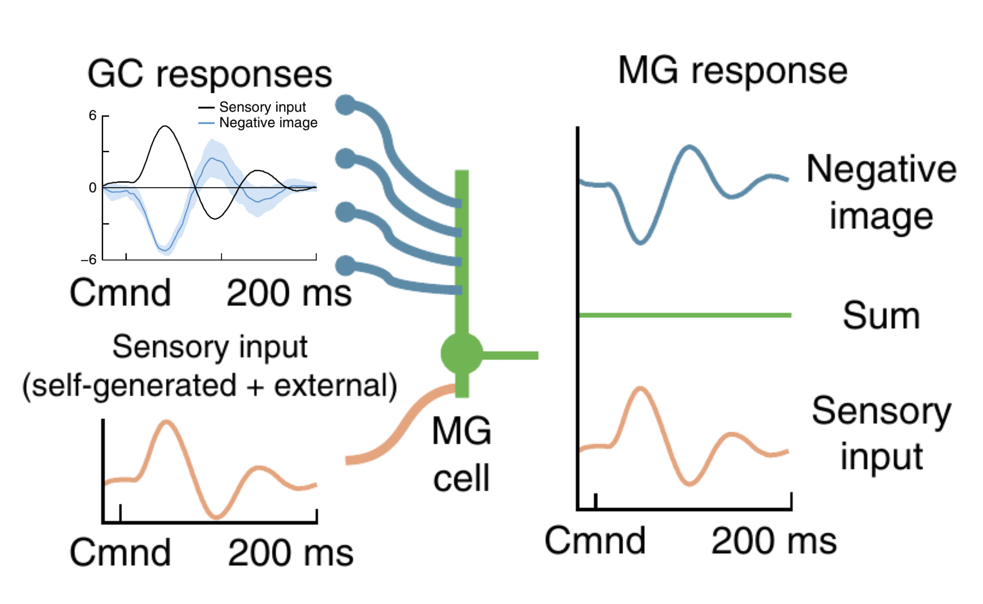
Electric fish learn to cancel self-generated signal
from Kennedy et al., 2014

Slide 9
Can a similar system explain PN responses?

Slide 10
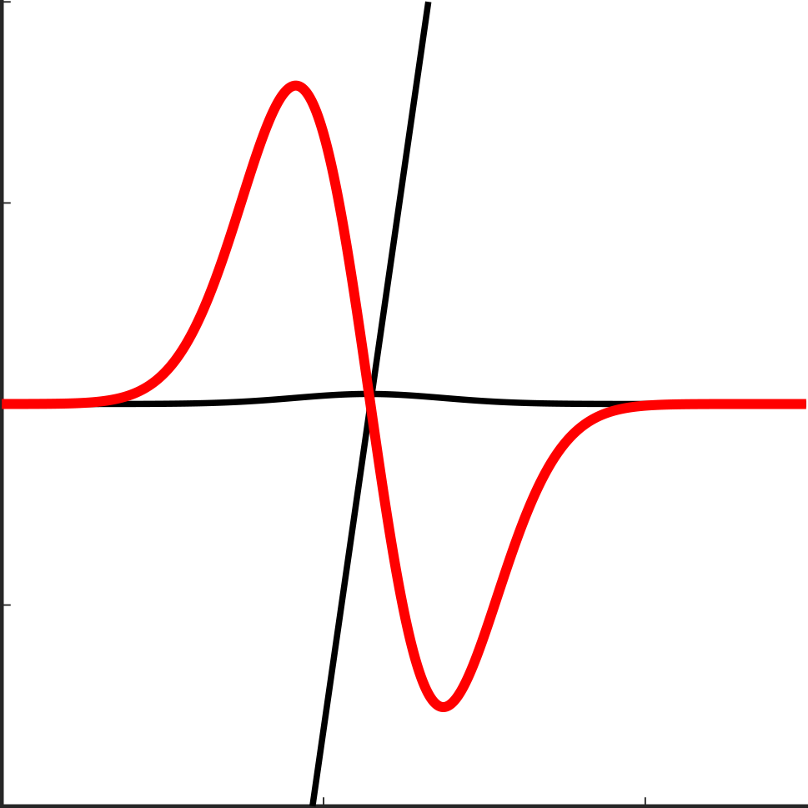
Linear model - Gaussian multiplied by line

Slide 11
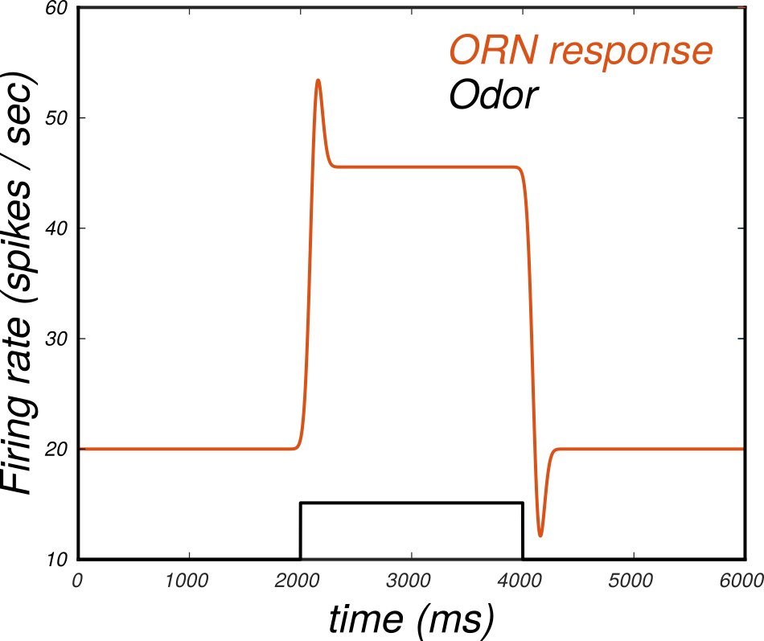
Linear model captures transient but is too symmetric

Slide 12
Issues
Symmetric on and off response
Lots of parameters

Slide 13
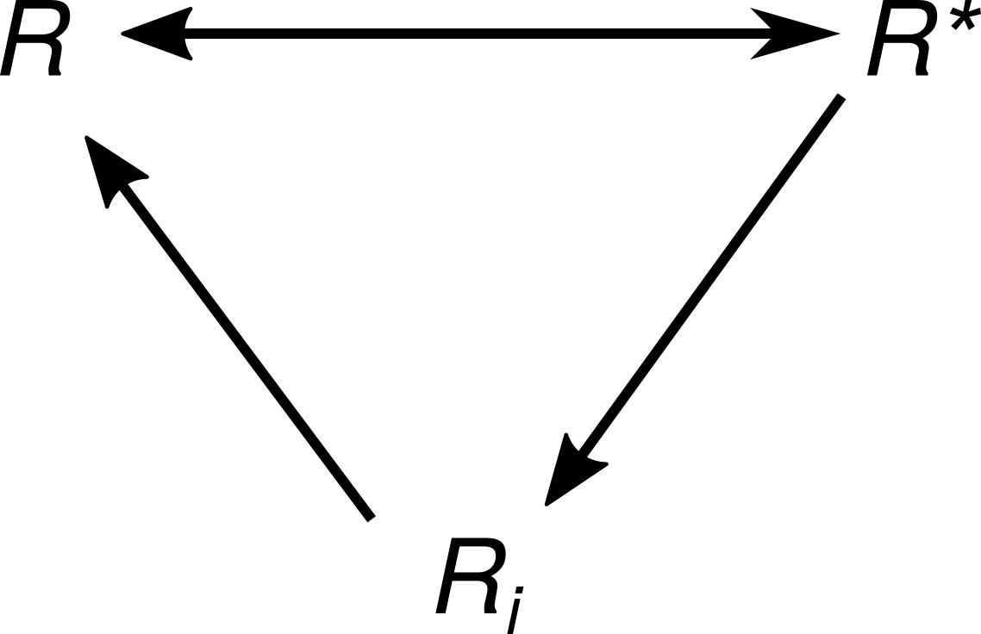
ORN dynamic model - schematic
NB: Only activation was odor-concentration dependent!

Slide 14
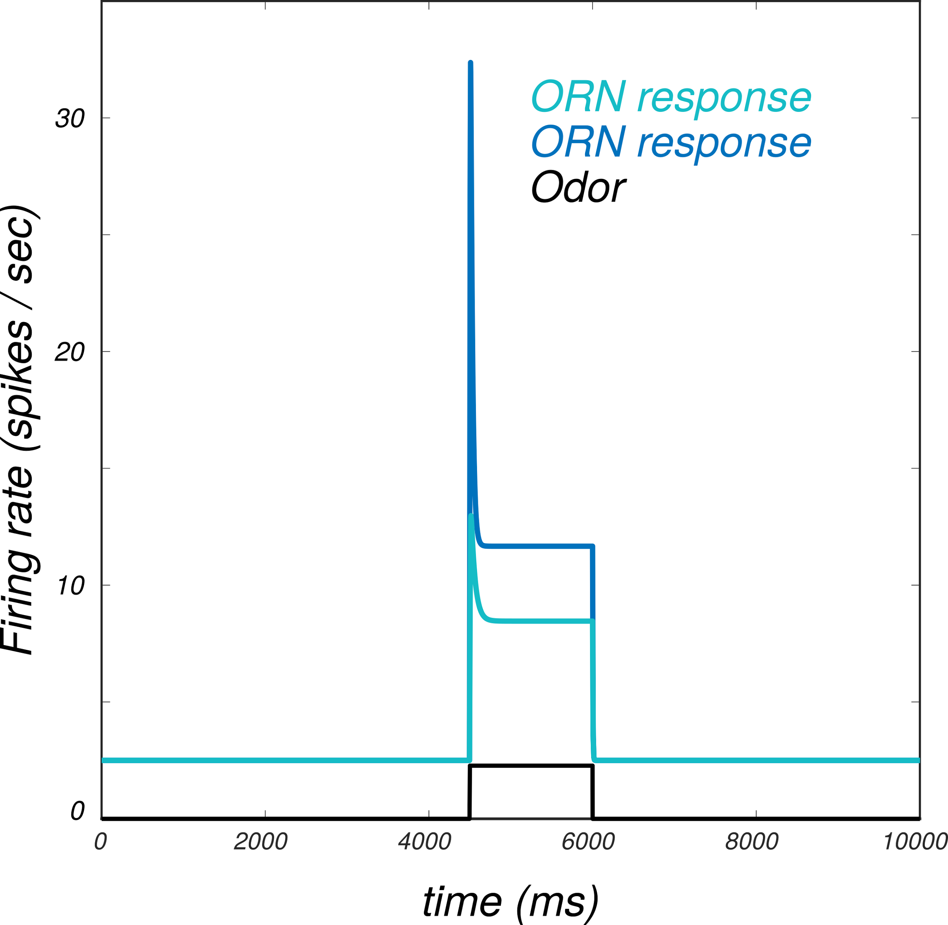
ORN model - dynamic model
from Nagel + Wilson, 2011

Slide 15
Model comparison

Slide 16
LN model framework
Number of LNs is the number of samples per stimulus
Each LN is a delta function at a fixed delay from odor onset
All ORNs project onto these delta functions

Slide 17
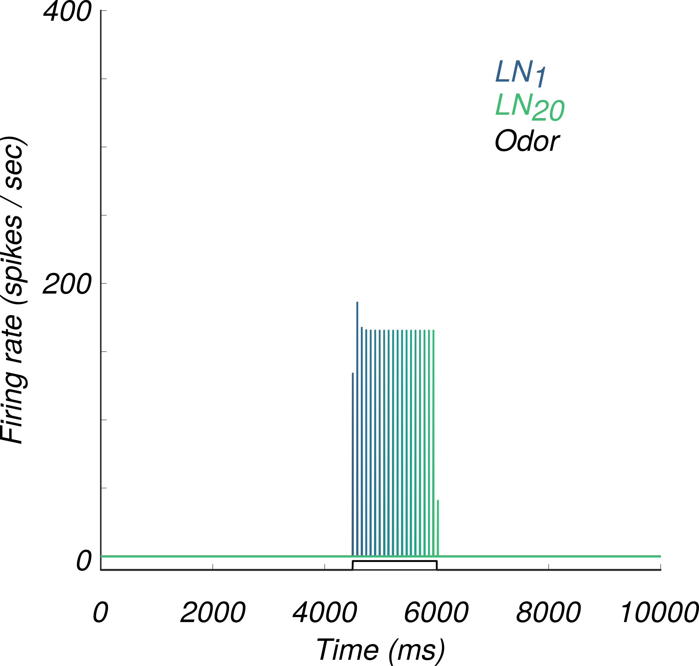
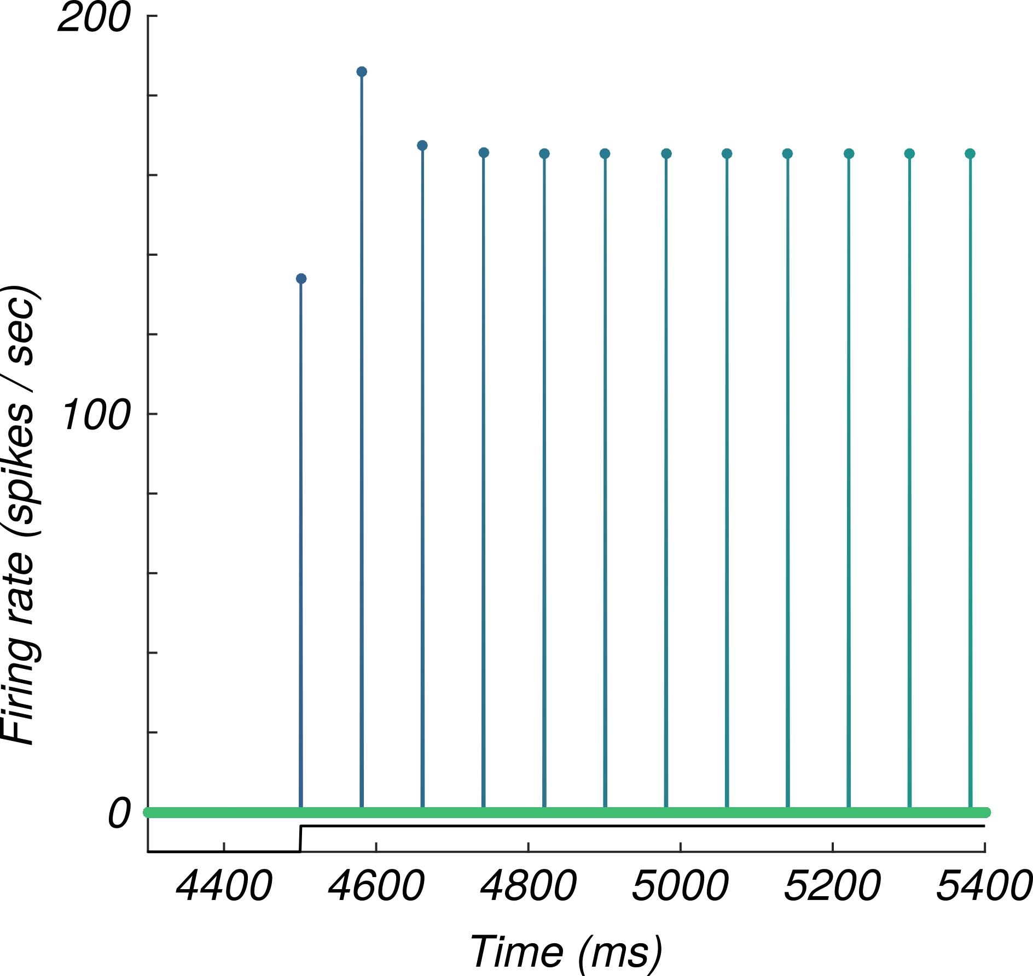
LN modelling - delay line

Slide 18
LN model framework
200 evenly spaced Gaussians comprise the bank of LNs
Firing rate is the projection of all ORNs onto a given LN

Slide 19
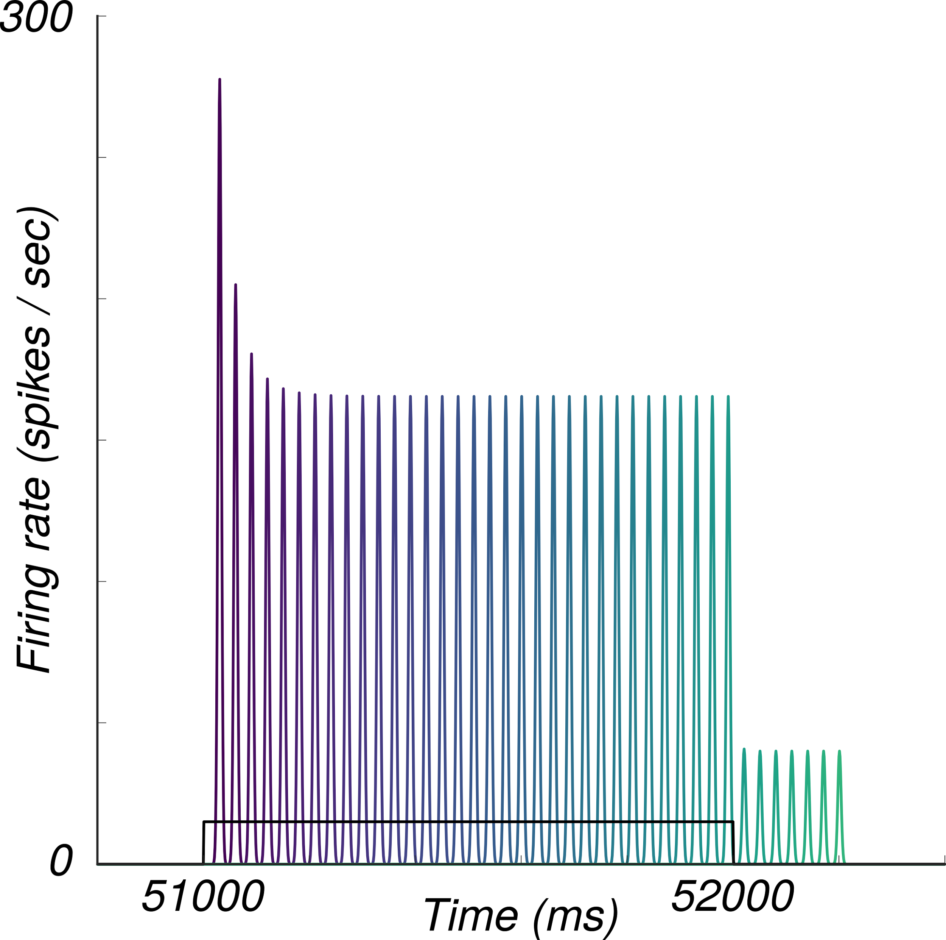
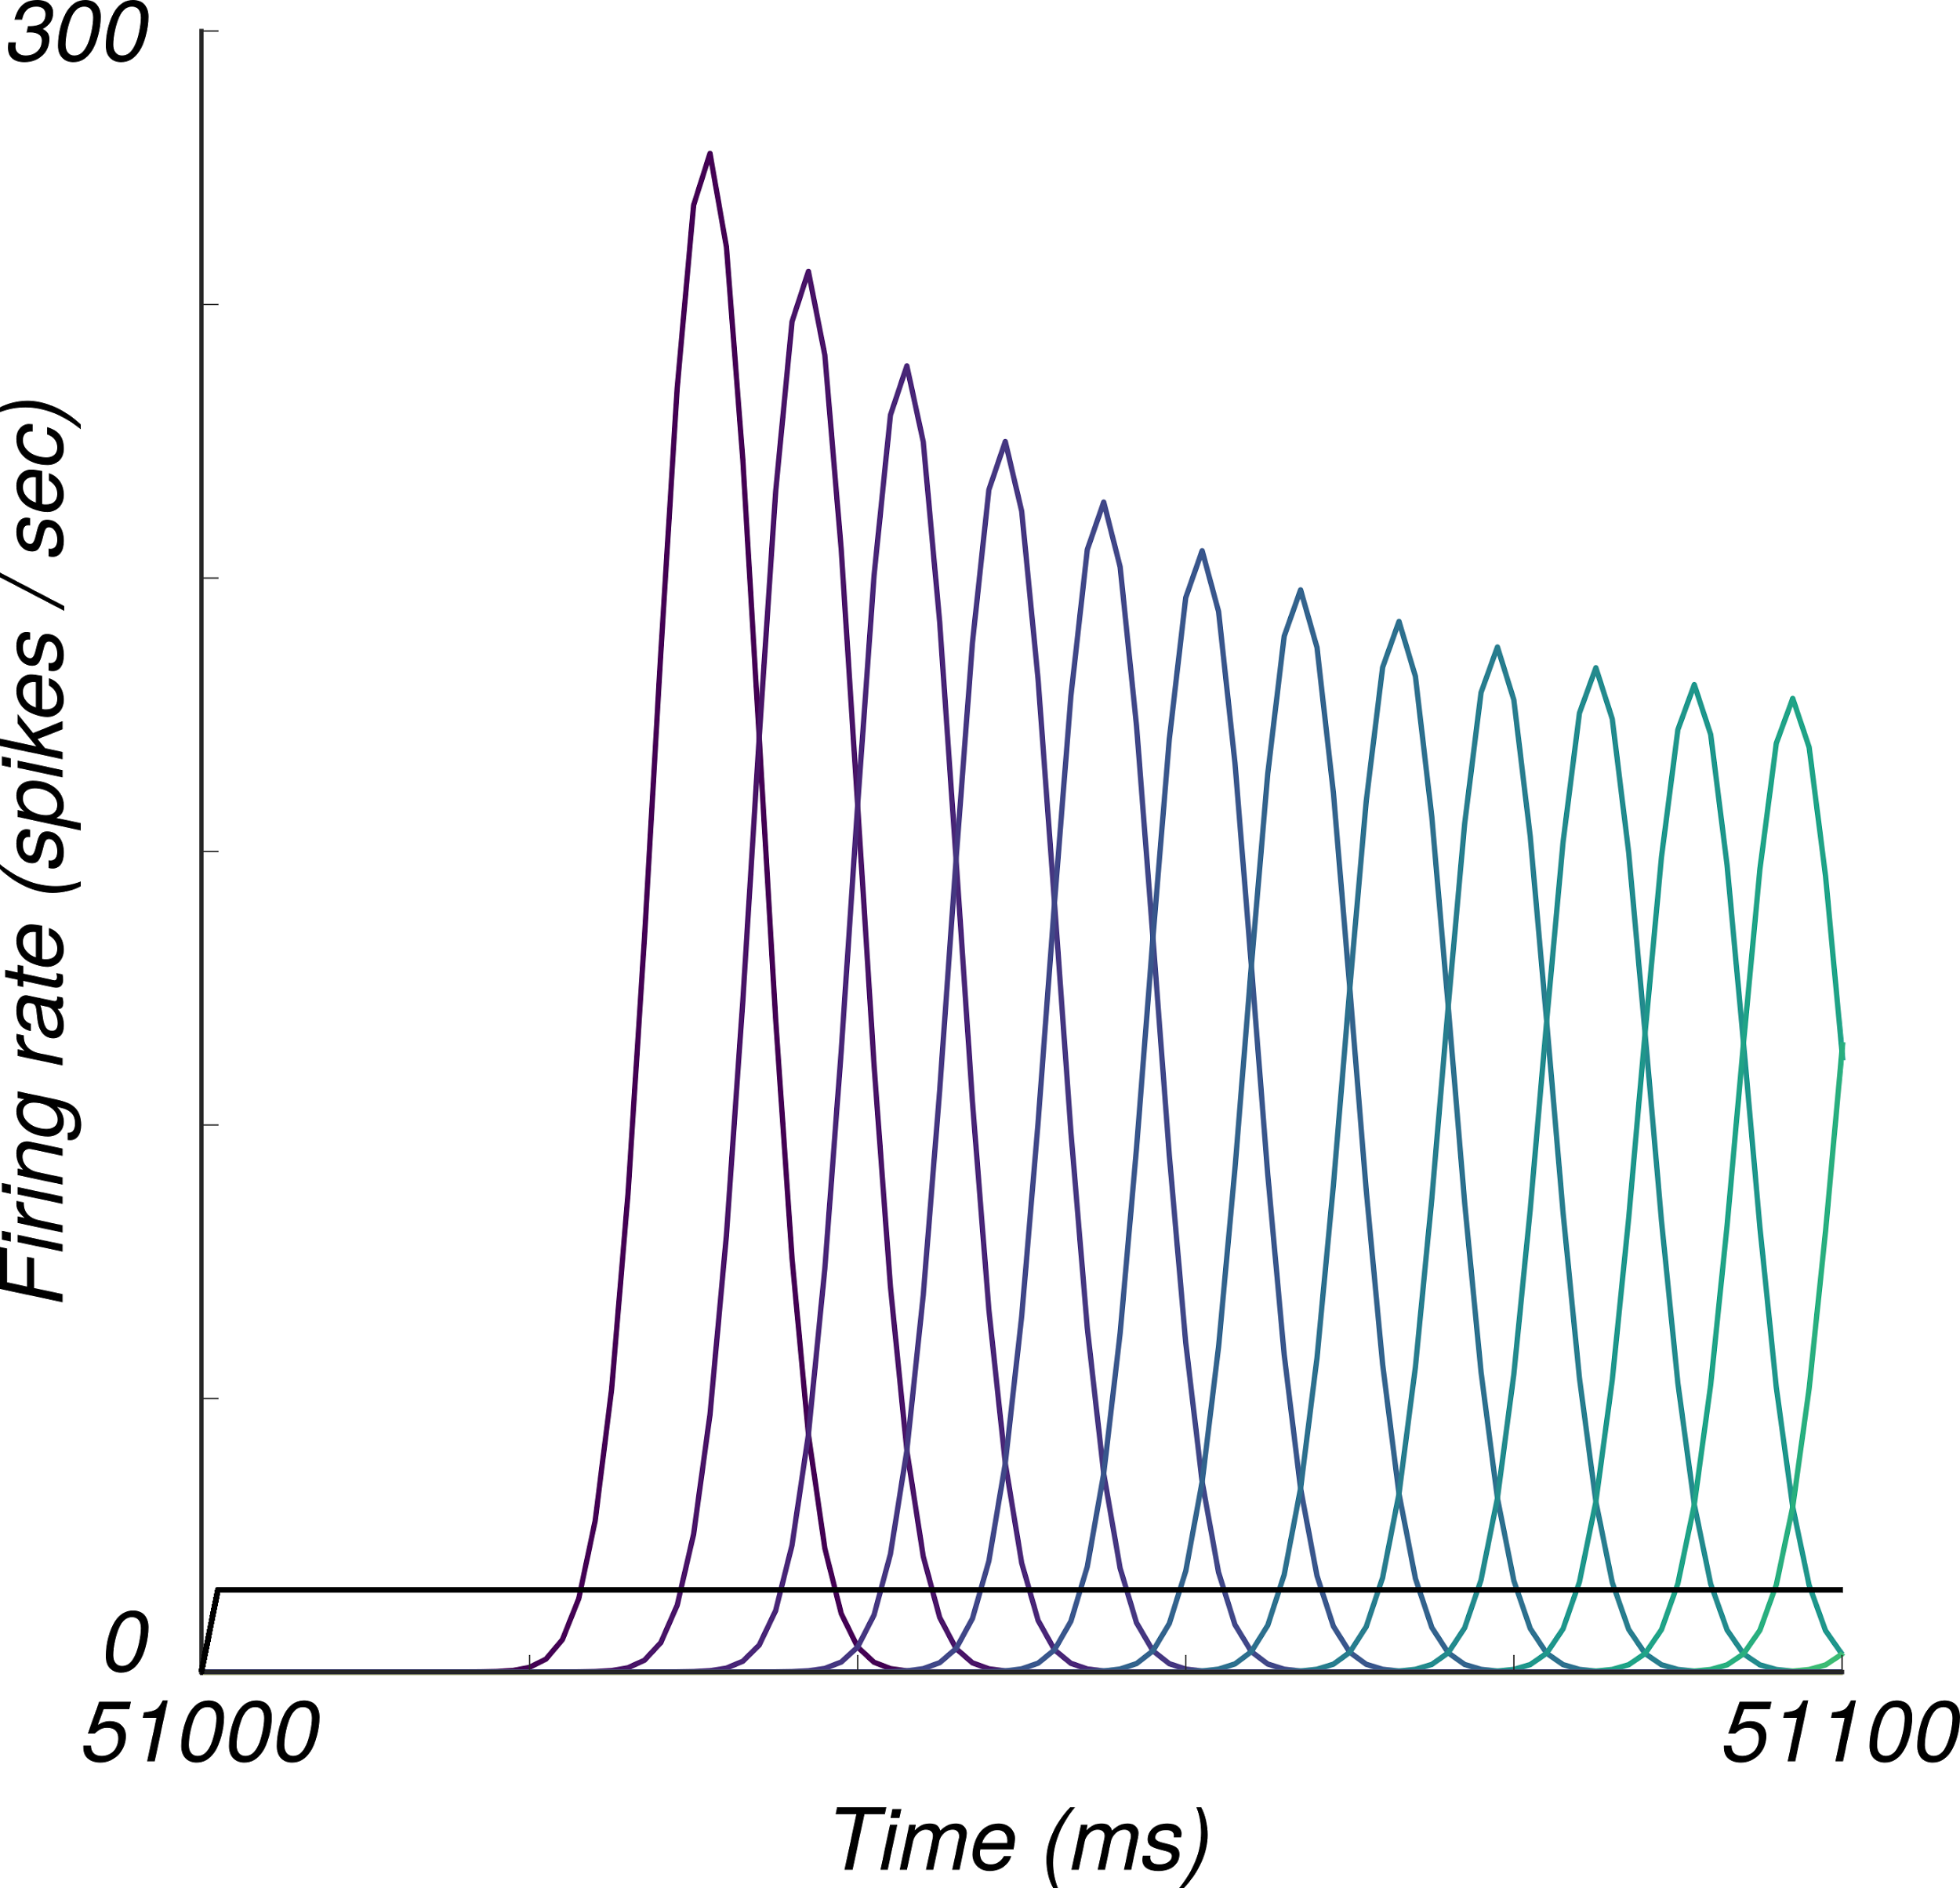
LN modelling - gaussian bank

Slide 20
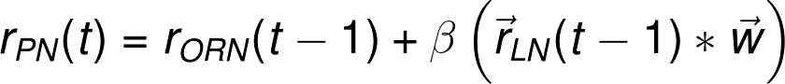
PN modelling

Slide 21
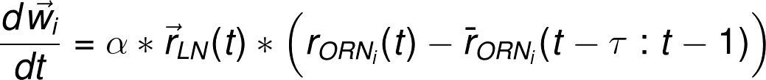
Weight adjustment

Slide 22
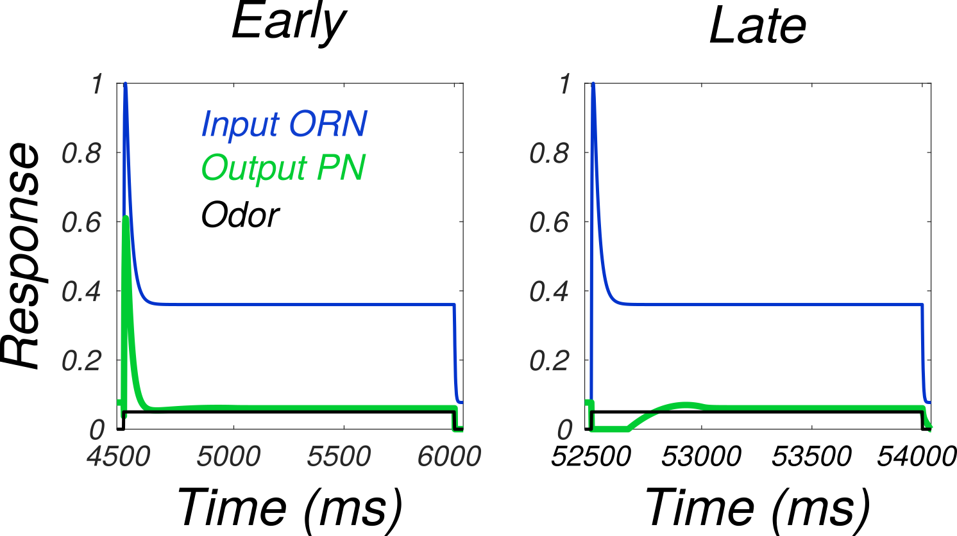
PN responses - balanced E/I

Slide 23
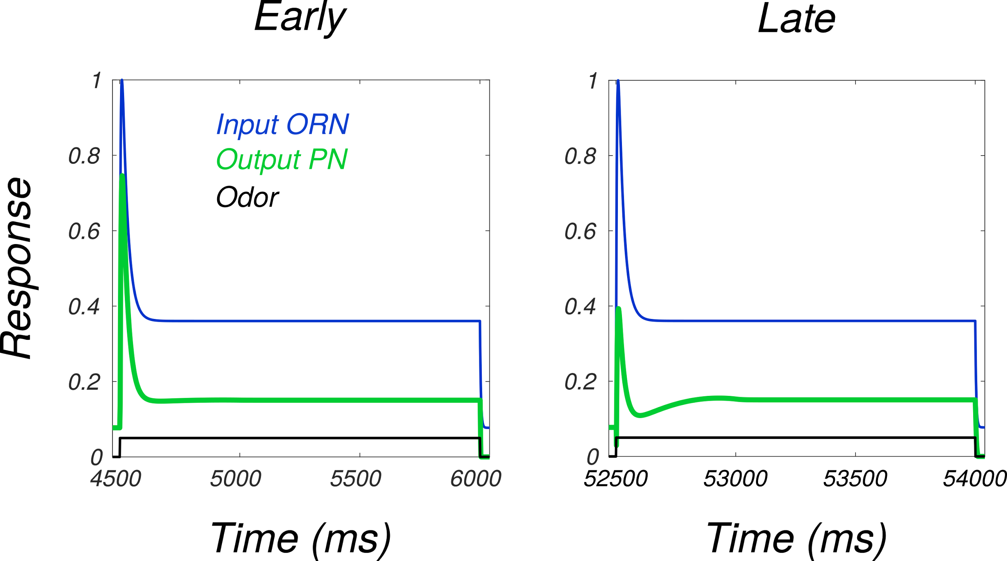
PN responses - weaker inhibition

Slide 24
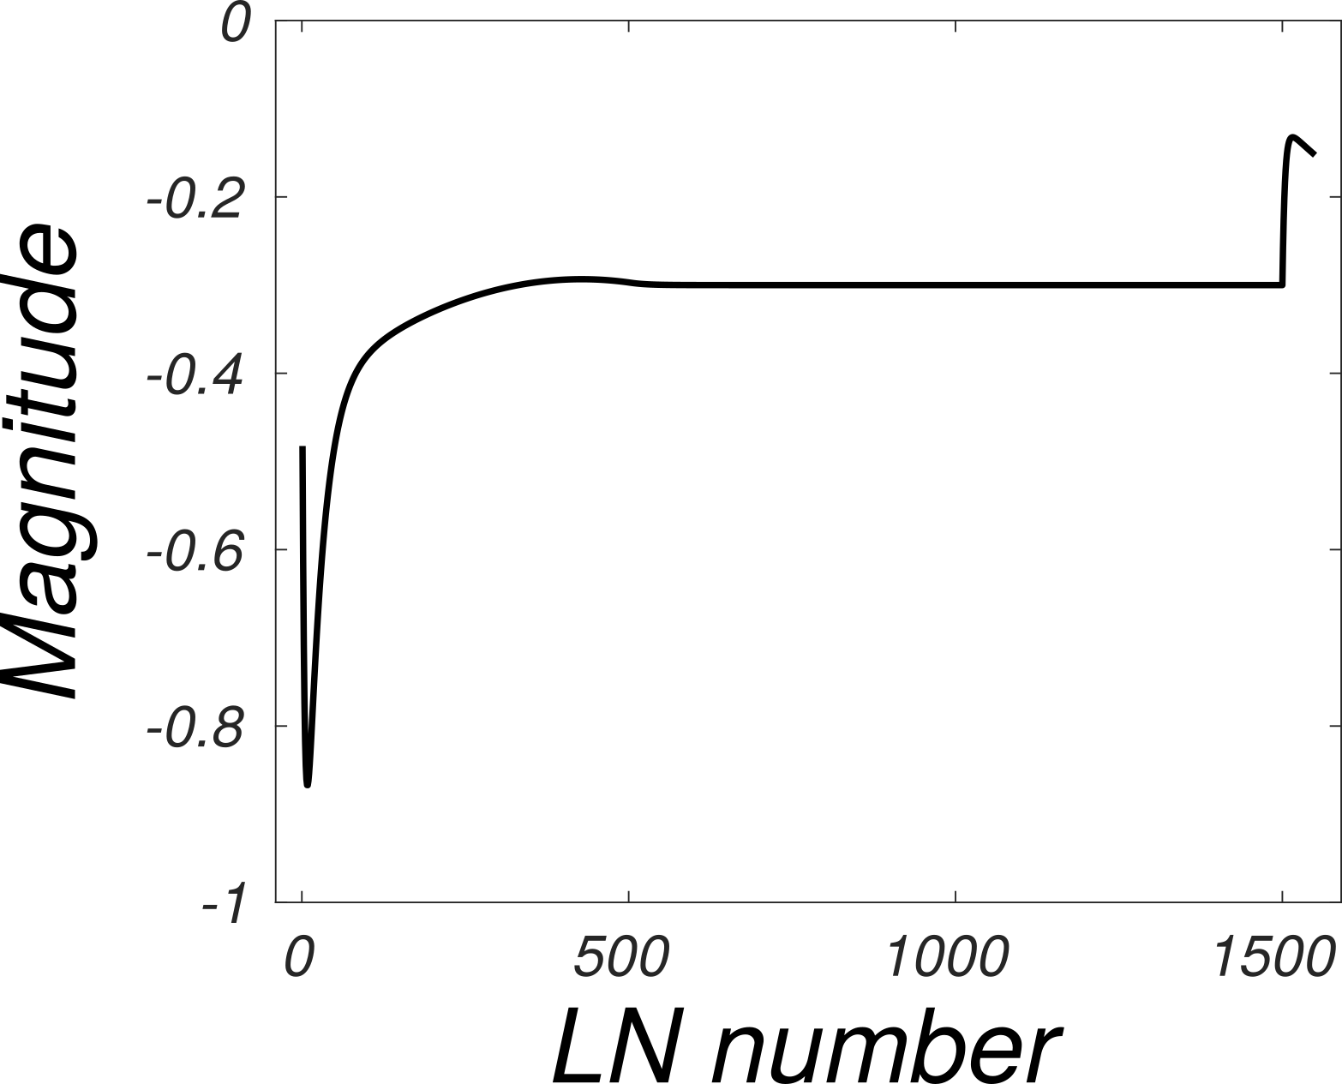
Weights

Slide 25
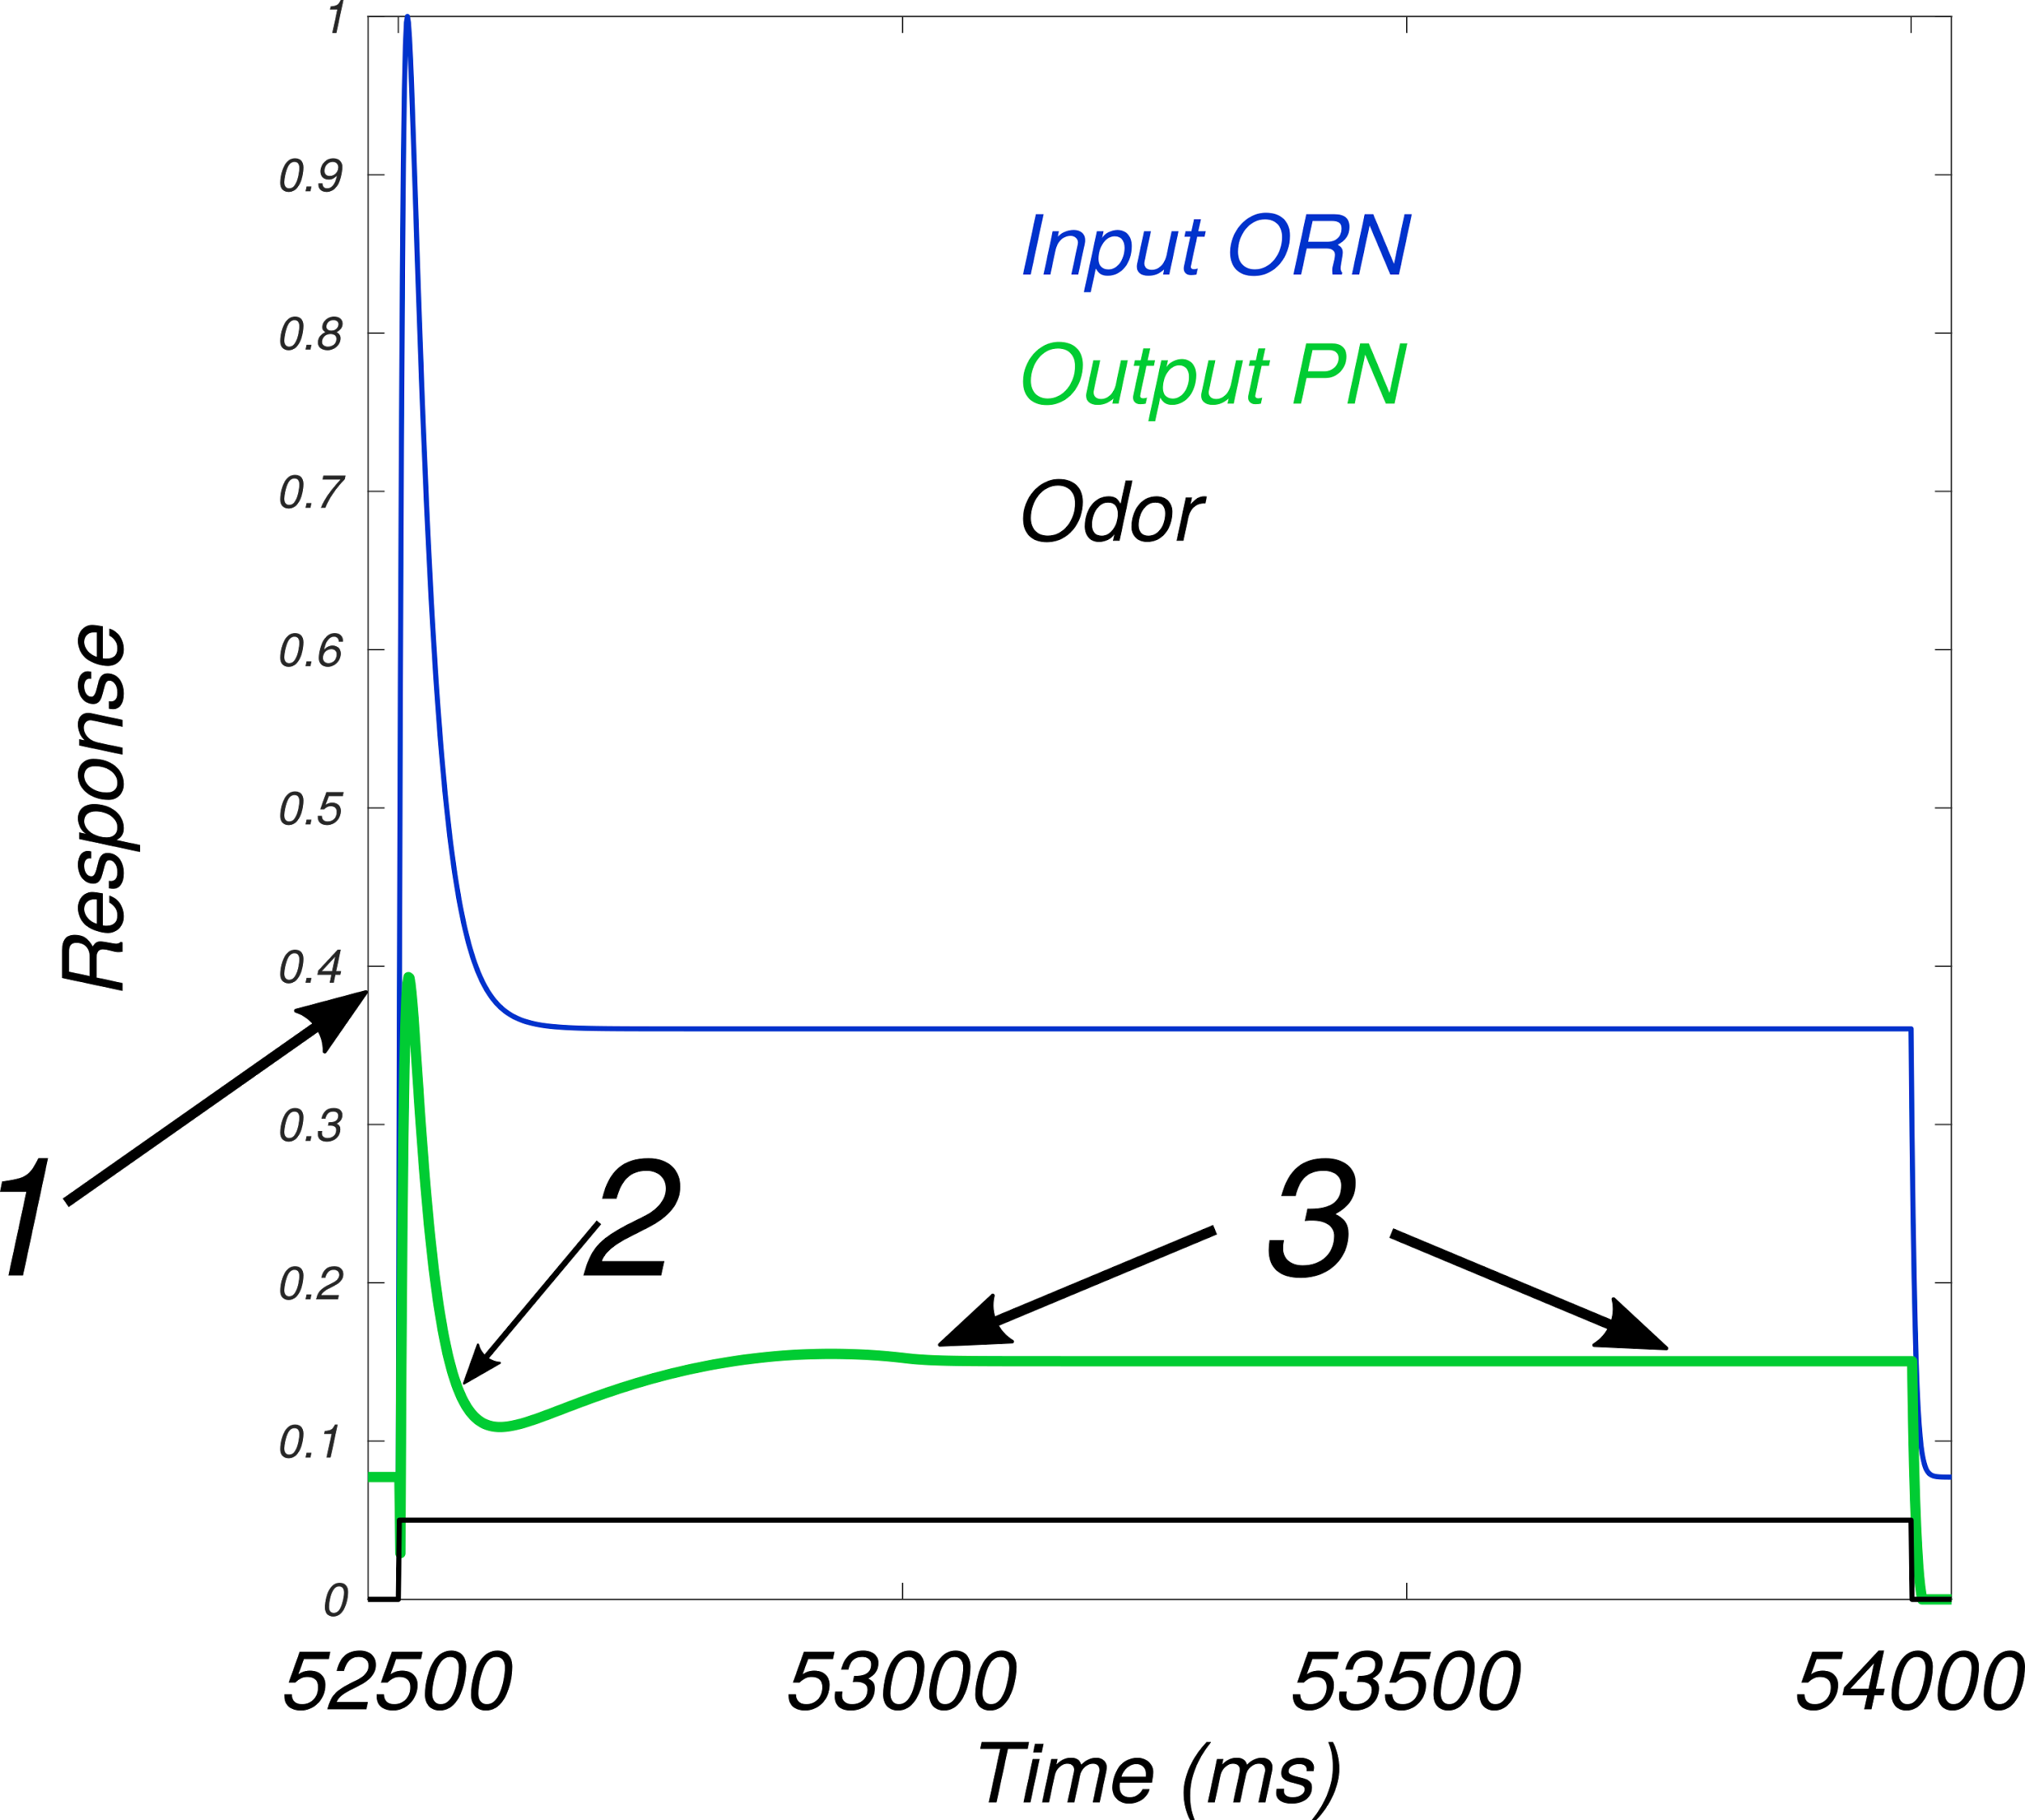
PN responses, explained
from Nagel et al., 2015

Slide 26
Summary
LN inhibition can decrease onset transients in PNs
The E/I balance is crucial for PN behavior

Slide 27
Thanks!

Slide 28
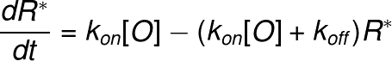
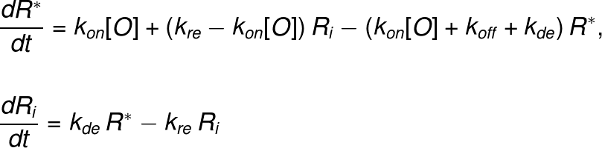
Math - ORN dynamic model

Slide 29
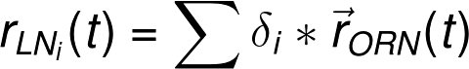
Math - LN delay line

